Slide 2
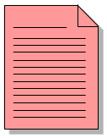

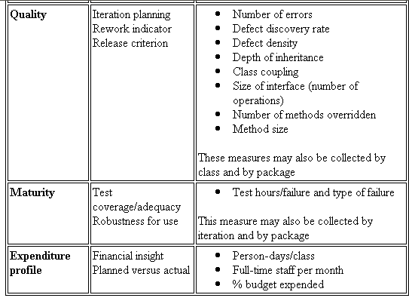


What is UML?
The Unified Modeling Language (UML) is a standard language for
Specifying
Visualizing
Constructing
Documenting
Business Modeling
Communications

Slide 3
Uses for UML
as a sketch: to communicate aspects of system
  forward design: doing UML before coding
  backward design: doing UML after coding as documentation
  often done on whiteboard or paper
  used to get rough selective ideas
as a blueprint: a complete design to be implemented
  sometimes done with CASE (Computer-Aided Software Engineering) tools
as a programming language: with the right tools, code can be auto-generated and executed from UML
  only good if this is faster than coding in a "real" language

Slide 4
Brief UML History
Around 1980
  first OO modelling languages
  other techniques, e.g. SA/SD
Around 1990
  "OO method wars"
  many modelling languages
End of 90's
  UML appears as combination of best practices

Slide 5
Static vs. Dynamic Models
Static model
  Static design describes code structure and object relations
  Describes static structure of a system
  Consists of a set of objects (classes) and their relationships
  Represented as class diagrams
Dynamic model
  Dynamic design shows communication between objects
  Describes dynamic behavior of a system, such as state transitions and interactions (message sends)
  Represented as statechart diagram, sequence diagrams, and collaboration diagrams

Slide 6
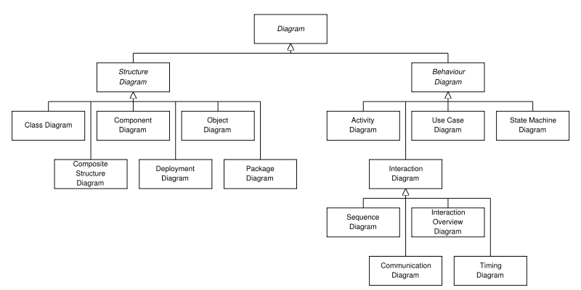

Slide 7
Modeling Requirements
Use Cases
Analysis
Classes
Design
Elements
Source
Code
Exec
(…from a structural perspective; static)
Notes:
OOADv4.2 Instructor Notes
Module 7 - Use-Case Analysis
Some of the work done in analysis is thrown away. This is not bad, since you need to play with the ideas to see what works and what doesn’t, but you should expect that much of the work done during analysis is a kind of ‘structured doodling’. The biggest mistakes happened when people assign too much value to the early results of analysis.
The need to define analysis classes in UML terms creates a sense that they are more formal than they are. An instructor once referred to analysis classes as “CRC-like
cards, on which you can scribble anything you want in the margins”.
This course concentrates on the development of a Design Model. Maintaining a separate Analysis Model would require some modifications to the presented activities, the discussion of which is out of the scope of this course.

Slide 8
Use Cases
A use case in UML is defined as a set of sequences of actions a system performs that yield an observable result of value to a particular actor.
Actions can involve communicating with number of actors as well as performing calculations and work inside the system.
A use case
  is always initiated by an actor.
  provides a value to an actor.
  must always be connected to at least one actor.
  must be a complete description.

Slide 9
Actors
An actor is something or someone that interacts with the system.
Actor communicates with the system by sending and receiving messages.
An actor provides the stimulus to activate an use case.
Message sent by an actor may result in more messages to actors and to use cases.
Actors can be ranked: primary and secondary; passive and active.
Actor is a role not an individual instance.

Slide 10
Use Case Diagram
Use case diagrams are created to visualize the relationships between actors and use cases
Request Course Roster
Student
Professor
Maintain Schedule
Billing System
Maintain Curriculum
Registrar
Copyright © 1997 by Rational Software Corporation
Notes:
18

Slide 11
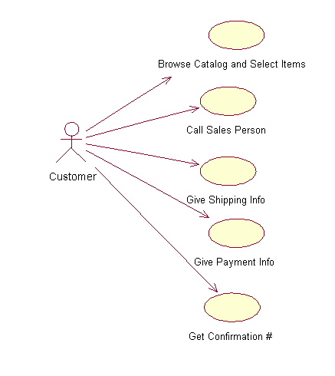
Use case diagram
System boundary
Actor
overview the usage requirements
presentations project stakeholders
"the meat" of the actual requirements
Actor:
An actor is a person, organization, or external system that plays a role in one or more interactions with your system
Use case
System boundary:
indicates the scope of your system. Anything within the box represents functionality that is in scope and anything outside the box is not
Online C2C shopping
Use case:
A use case describes a sequence of actions that provide something of measurable value to an actor and is drawn as a horizontal ellipse
Notes:
System boundary:
indicates the scope of your system. Anything within the box represents functionality that is in scope and anything outside the box is not
Use case:
A use case describes a sequence of actions that provide something of measurable value to an actor and is drawn as a horizontal ellipse
Actor:
An actor is a person, organization, or external system that plays a role in one or more interactions with your system

Slide 12
Modeling Requirements
Use Cases
Analysis
Classes
Design
Elements
Source
Code
Exec
(…from a structural perspective; static)
Notes:
OOADv4.2 Instructor Notes
Module 7 - Use-Case Analysis
Some of the work done in analysis is thrown away. This is not bad, since you need to play with the ideas to see what works and what doesn’t, but you should expect that much of the work done during analysis is a kind of ‘structured doodling’. The biggest mistakes happened when people assign too much value to the early results of analysis.
The need to define analysis classes in UML terms creates a sense that they are more formal than they are. An instructor once referred to analysis classes as “CRC-like
cards, on which you can scribble anything you want in the margins”.
This course concentrates on the development of a Design Model. Maintaining a separate Analysis Model would require some modifications to the presented activities, the discussion of which is out of the scope of this course.

Slide 13
Use-Case Analysis Steps
Supplement the Use-Case Description
For each use-case realization
  Find Classes from Use-Case Behavior
  Distribute Use-Case Behavior to Classes
For each resulting analysis class
  Describe Responsibilities
  Describe Attributes
  Describe Associations
  Describe Event Dependencies

Slide 14
Supplement the Use-Case Description
➔ Sometimes the description of
the use case is not sufficient
for identifying analysis classes and
their objects.
Remember, customer doesn’t
care about the inside of the
system, so many details may
have been left out – leaving the
use case description like a black
box.
To find objects that perform the
use cases, we may need ‘white
box’ descriptions – that is, what does
the system do from an internal
perspective. From this, some objects
may be identified.
Many times we do not have
enough detail.
The system retrieves and displays a list of current course offerings from the course catalog legacy database
given specific
parameters, such as...
The system displays a list of course offerings.
Notes:
OOADv4.2 Instructor Notes
Module 7 - Use-Case Analysis
One technique for capturing this additional detail if Word is used to document the use cases is to add the detail in the form of comments in the Word document. That way the detail can be “turned on or off”, depending on the audience.

Slide 15
Supplement the Use-Case Description
Add detail information to Use-Case description
To find the objects which perform the use case
you need to have the ‘white box’ description of what the system does from an internal perspective

Slide 16
Use-Case Analysis Steps
Supplement the Use-Case Description
For each use-case realization
  Find Classes from Use-Case Behavior
  Distribute Use-Case Behavior to Classes
For each resulting analysis class
  Describe Responsibilities
  Describe Attributes
  Describe Associations
  Describe Event Dependencies

Slide 17
Classes
A class is the description of a set of objects having similar attributes, operations, relationships and behavior.
Class Name
Window
size
visibility
Attributes
display()
hide()
Operations
UML Class Diagrams

Slide 18
For each use-case realization
Find Classes from Use-Case Behavior
Find Classes From Use-Case Behavior
<<boundary>>
  User interface classes
    what information is presented to the user
  System interface classes
  Device Interface classes
    what protocols must be defined
  One boundary class
  per actor/use case pair
<<control>>
  Use-Case behavior coordinator
  One control class per use case
<<entity>>
  System information

Slide 19
Find Candidate Classes from Behavior
Boundary classes are those classes that lies on the boundary between your system and the rest of the world.
Entity classes hold information that you will save to persistent storage.
Control classes are responsible for coordinating the effort of other classes

Slide 20
Find Classes From Use-Case Behavior
The complete behavior of a use case must be distributed to analysis classes
<<boundary>>
<<control>>
<<boundary>>
<<entity>>
<<entity>>
Notes:
OOADv4.2 Instructor Notes
Module 7 - Use-Case Analysis
Do you find classes or objects first? Some people naturally think in abstractions. They find classes first. Others think concretely. They find objects first and then abstract these objects into classes.
Note: RUP ships with a set of special icons to visually represent these different types of classes. We have chosen not to use the RUP stereotypes in this course (they served to be too much of a distraction to the students).

Slide 21
Boundary Classes
Models the interaction between the system’s surroundings and its inner workings
  User interface classes
    Concentrate on what information is presented to the user
    Don’t concentrate on user interface details
    Example:
      ReportDetailsForm
      ConfirmationDialog
  System / Device interface classes
    Concentrate on what protocols must be defined. Don’t concentrate on how the protocols are implemented
UML Class Diagrams

Slide 22
What is a Boundary Class?
Insulates the system from changes in the outside
Several Types of Boundary Classes
  1. User interface classes – classes that facilitate communication with human users of the system
    Menus, forms, etc. User interface classes….
  2. System interface classes – classes which facilitate communications with other systems. Very Important!
    These boundary classes are responsible for managing the dialogue with the external system, like getting data from an existing database system or flat file…
    Provide an interface to that system
  3. Device Interface Classes – provide an interface to devices which detect external events – like a sensor
Notes:
OOADv4.2 Instructor Notes
Module 7 - Use-Case Analysis

Slide 23
The Role of a Boundary Class
Actors can only communicate with boundary classes.
Boundary classes identify the system’s boundaries.
<<boundary>>
<<control>>
<<boundary>>
Customer
External
Database??
<<boundary>>
<<entity>>
<<entity>>
A boundary class is a class used to model interaction between the system’s surroundings
and its inner workings.
Boundary Classes model parts of the system that depend on its surroundings.
Entity and control classes model parts that are independent of system’s surroundings.
. Examples of boundary classes: Classes that handle GUI or communications protocols.
Notes:
OOADv4.2 Instructor Notes
Module 7 - Use-Case Analysis

Slide 24
Example: Finding Boundary Classes
One boundary class per actor/use case pair:
Student
Register for Courses
Course Catalog System
Two boundary classes:
<<boundary>>
RegisterForCoursesForm
<<boundary>>
CourseCatalogSystem
The RegisterForCoursesForm contains a Student's "schedule-in-progress". It interfaces
with the actor and displays a list of Course Offerings for the current semester from which
the Student may select specific courses to be added to his/her Schedule.
The CourseCatalogSystem interfaces with the legacy system that provides the
unabridged catalog of all courses offered by the university.
Notes:
OOADv4.2 Instructor Notes
Module 7 - Use-Case Analysis

Slide 25
Entity Classes
Entity classes represent stores of information in the system
They are usually persistent, having attributes and relationships needed for a long period, sometimes for the life of the system.
The main responsibilities of entity classes are to store and manage information in the system.

Slide 26
Candidate Entity Classes - continued
Sometimes there is a need to model information about an actor within the system. This is not the same as modeling the actor (actors are external. by definition).
For example, a course registration system maintains information about the Student which is independent of the fact that the Student also plays a role as an Actor of the system.
  This information about the student that is stored in a ‘Student’ class is completely independent of the ‘actor’ role the student plays;
  The Student class (entity) will exist whether or not the student is an actor to the system.

Slide 27
Entity Classes
Models the key concepts of the system
Usually models information that is persistent
Contains the logic that solves the system problem
Can be used in multiple behaviors
Example: Violation, Report, Offender.
UML Class Diagrams

Slide 28
Control Classes
Controls and coordinates the behavior of the system
Delegates the work to other classes
  A control class should tell other classes to do something and should never do anything except for directing
Control classes decouple boundary and entity classes
Example:
  EditReportController
  AddViolationController
UML Class Diagrams

Slide 29
Control Classes
A Control Class is a class used to model control behavior specific to one or more use cases.
Control classes encapsulate use-case-specific behavior.
The behavior of a control object is closely related to the realization of a specific use case.
In many scenarios, you might even say that the control objects "run" the use-case realizations.
  Some control objects can participate in more than one use-case realization if the use-case tasks are strongly related.
  Similarly, some use cases may require more than one control class; but in general, there is a one-to-one correspondence – as a heuristic.

Slide 30
What is a Control Class?
Use-case behavior coordinator
One control class per use case
<<control>>
Use Case
Notes:
OOADv4.2 Instructor Notes
Module 7 - Use-Case Analysis
One recommendation for the initial identification of control classes is one control class per use-case. This may be refined as a more detailed analysis is performed.
Control classes are to be used to isolate use-case-specific responsibilities/behavior, not to be “do-all, be-all” classes. Control classes contain behavior that doesn’t belong in entity and boundary classes.
Stress that the control classes know how to “orchestrate and delegate”. They don’t do everything, but they know the order in which things should be done. In many cases, these control classes are “designed away” in Class Design (e.g., may become methods in UI classes). In analysis, however, they allow the analyst to allocate that use-case-specific behavior and move on.

Slide 31
Control Classes – not always needed
Control classes provide coordinating behavior in the system.
  The system sometimes can perform some use cases without control classes (just using entity and boundary classes) – particularly use cases that involve only the simple manipulation of stored information.
Complex use cases generally require one or more control classes to coordinate the behavior of other objects in the system.
➔ Examples of control classes include transaction managers, resource coordinators and error handlers.

Slide 32
Control Classes decouple:
Control classes effectively decouple boundary and entity objects from one another, making the system more tolerant of changes in the system boundary.
They also decouple the use-case specific behavior from the entity objects, making them (the entity objects) more reusable across use cases and systems.
  Reverse engineer existing GUI components?? Very possible! Quite likely.
  Note: we are in the initial stages of ‘design’
  Decoupling affects some of the non-functional requirements (that are addressed in design in considerable detail), such as maintainability, performance, reusability.

Slide 33
Control Class provided behavior:
Is surroundings-independent (does not change when the surroundings change)
Defines control logic
  Order between events and transactions within a use case.
  Changes little if the internal structure or behavior of the entity classes changes
Uses or sets the contents of several entity classes, and therefore needs to coordinate the behavior of these entity classes (gets and sets and sequencing…)
Is not performed in the same way every time it is activated (flow of events features several states)
One recommendation for the initial identification of control classes is one control class per use case.

Slide 34
The Role of a Control Class
<<boundary>>
<<control>>
Customer
<<boundary>>
Database
<<boundary>>
<<entity>>
<<entity>>
Coordinate the use-case behavior
Several control objects of different control classes can participate in one use case.
As stated, not all use cases require a control object.
Example: if the flow of events in a use case is related to one entity object,
a boundary object may realize the use case in cooperation with the entity object.
You can start by identifying one control class per use case realization, and then refine
this as more use-case realizations are identified and commonality is discovered.
Notes:
OOADv4.2 Instructor Notes
Module 7 - Use-Case Analysis

Slide 35
Role of Control Class
Control classes can contribute to understanding the system because they represent the dynamics of the system, handling the main tasks and control flows.
When the system performs the use case, a control object is created.
Control objects usually die when their corresponding use case has been performed.
  (Normally NOT persistent)

Slide 36
Example: Finding Control Classes
Recommend: Identify one control class per use case (again)
Student
Register for Courses
Course Catalog System
<<control>>
RegistrationController
Each control class is responsible for orchestrating/controlling the processing that
implements the functionality described in the associated use case.
Here, the RegistrationController <<control>> class has been defined to orchestrate
the Register for Courses processing within the system.
➔ (Controller accepts inputs, ‘knows’ where required data and functionality reside,
sends key messages to entities, sequences all actions to satisfy use case, sends data back
to input actor, etc….)
Notes:
OOADv4.2 Instructor Notes
Module 7 - Use-Case Analysis

Slide 37
Use-Case Analysis Steps
Supplement the Use-Case Description
For each use-case realization
  Find Classes from Use-Case Behavior
  Distribute Use-Case Behavior to Classes
For each resulting analysis class
  Describe Responsibilities
  Describe Attributes
  Describe Associations
  Describe Event Dependencies

Slide 38
Objects vs. Classes
 | Interpretation in the Real World | Representation in the Model
Object | An object represents anything in the real world that can be distinctly identified. | An object has an identity, a state, and a behavior.
Class | A class represents a set of objects with similar characteristics and behavior. These objects are called instances of the class. | A class characterizes the structure of states and behaviors that are shared by all of its instances.

Slide 39
Object = Identity + State + Behavior
Identity
  Distinguishes an object from all other objects.
State
  Consists of a set of attributes (or fields), which have names, types, and values.
Behavior
  Defined by the set of operations (or methods) that may operate on the object.
  Each method has a name, a type, and a value, where
    The type consists of the return type and the list of parameter types of the method, often called signature.
    The value is the implementation of the method often expressed as a sequence of statements, in languages like Java and C++.

Slide 40
Class
Characterizes the structure of states and the behaviors shared by all instances.
Defines a template for creating or instantiating instances.
  Names and types of all fields
  Names, signatures, and implementations of all methods.

Slide 41
Object communication
Conceptually, objects communicate by
message passing.
Messages
  The name of the service requested by the calling object;
  Copies of the information required to execute the service
  and the name of a holder for the result of the service.
In practice, messages are often implemented
by procedure calls
  Name = procedure name;
  Information = parameter list.

Slide 42
Notation for Objects
Rectangular box with one or two compartments
objectName: Classname
field₁ = value₁ …… field_{n} = value_{n}
The top compartment shows the name of the object and its class.
The bottom compartment contains a list of the fields and their values.
p1:Point
x = 10 y = 20
p2:Point
x = 20 y = 30

Slide 43
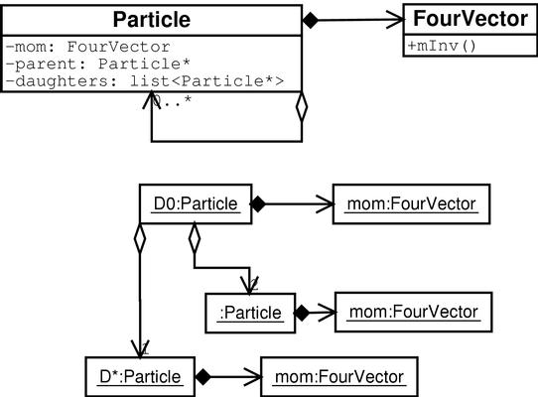
Object Diagram
Class diagram
never changes
Object diagram shows
relations at instant in time
(snapshot)
Object relations are drawn
using the class association
lines

Slide 44
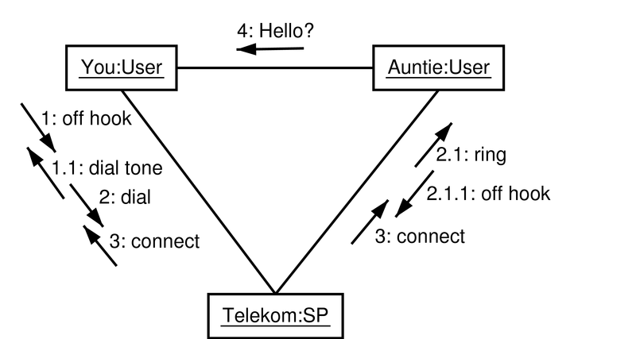
Collaboration Diagram
Object diagram with
numbered messages
Sequence numbers of messages
are nested by procedure call

Slide 45
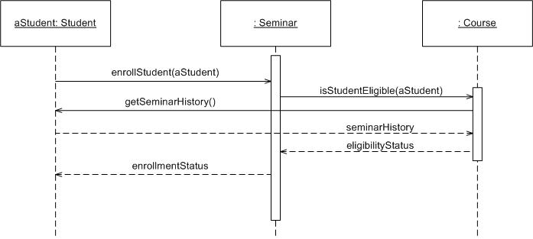
Sequence Diagram
Object: Class
A sequence diagram is
An interaction diagram that details how operations are carried out.
What messages are sent and when.
Sequence diagrams are organized according to time
Message
Operations
Lifeline

Slide 46
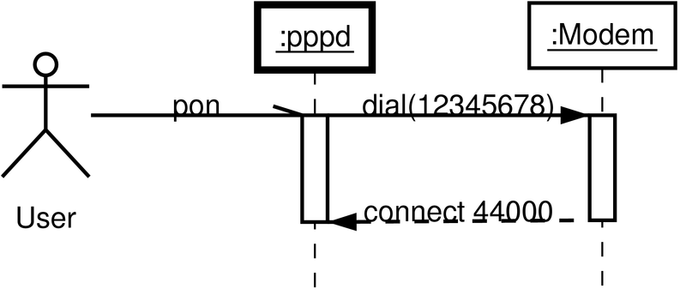
Sequence Diagram
Show sequence of events for a particular use case
Active object
Object
Lifeline
Activation
Messages
half-arrow=asynchronous,
full arrow=synchronous, dashed=return

Slide 47
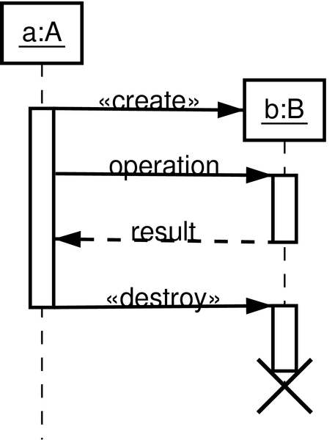
Sequence Diagram
Can show creation and
destruction of objects
Destruction mark

Slide 48
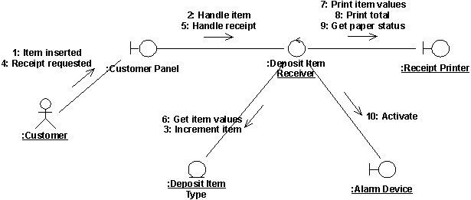
Distribute Behavior to Analysis Classes

Slide 49
Use-Case Analysis Steps
Supplement the Use-Case Description
For each use-case realization
  Find Classes from Use-Case Behavior
  Distribute Use-Case Behavior to Classes
For each resulting analysis class
  Describe Responsibilities
  Describe Attributes
  Describe Associations
  Describe Event Dependencies

Slide 50
Notation for Classes
The UML notation for classes is a rectangular box with as many as three compartments.
ClassName
field₁ …… field_{n}
method₁ … method_{n}
The top compartment show the class name.
The middle compartment contains the
declarations of the fields, or attributes, of the class.
The bottom compartment contains the
declarations of the methods of the class.

Slide 51
For each resulting analysis class
Describe Responsibilities
A responsibility is a statement of something an object can be asked to provide. Responsibilities evolve into one (but usually more) operations on classes in design; they can be characterized as:
The actions that the object can perform.
The knowledge that the object maintains and provides to other objects. Responsibilities are derived from messages in collaboration diagrams.
For each message, examine the class of the object to which the message is sent. If the responsibility does not yet exist, create a new responsibility that provides the requested behavior.
Other responsibilities will derive from non-functional requirements.

Slide 52
For each resulting analysis class
Describe Attributes
Attributes are used to store information by a class. Specifically, attributes are used where the information is:
Referred to "by value"; that is, it is only the value of the information, not it's location or object identifier which is important.
Uniquely "owned" by the object to which it belongs; no other objects refer to the information.
Accessed by operations which only get, set or perform simple transformations on the information; the information has no "real" behavior other than providing its value.
Finding Attributes
  Properties/characteristics of the class
  information retained by the class
  “Noun” that did not become classes

Slide 53
For each resulting analysis class
Describe Attributes
If the information has complex behavior, is shared by two or more objects, or is passed "by reference" between two or more objects, the information should be modeled as a separate class.
The attribute name should be a noun that clearly states what information the attribute holds.

Slide 54
For each resulting analysis class
Describe Associations
Start by studying the links in the collaboration diagrams
Find Relationships
  Association ← Link
  Aggregation
  Role Names
  Multiplicity
  can be multiple associations

Slide 55
Relationships between Class Diagrams
Association -- a relationship between instances of the two classes. There is an association between two classes if an instance of one class must know about the other in order to perform its work. In a diagram, an association is a link connecting two classes.
Aggregation -- an association in which one class belongs to a collection. An aggregation has a diamond end pointing to the part containing the whole.
Generalization -- an inheritance link indicating one class is a superclass of the other. A generalization has a triangle pointing to the superclass.

Slide 56
Associations
A semantic relationship between two or more classes that specifies connections among their instances.
A structural relationship, specifying that objects of one class are connected to objects of a second (possibly the same) class.
Example: “An Employee works for a Company”
Employee
Department
Company
UML Class Diagrams

Slide 57
Associations
An association between two classes indicates that objects at one end of an association “recognize” objects at the other end and may send messages to them.
  This property will help us discover less trivial associations using interaction diagrams.
UML Class Diagrams

Slide 58
Associations
Role name
Association name
instructor
StaffMember
Student
1..*
instructs
*
Role
Navigable
(uni-directional) association
Multiplicity
*
pre -
requisites
Courses
0..3
Reflexive association
UML Class Diagrams

Slide 59
Associations
To clarify its meaning, an association may be named.
  The name is represented as a label placed midway along the association line.
  Usually a verb or a verb phrase.
A role is an end of an association where it connects to a class.
  May be named to indicate the role played by the class attached to the end of the association path.
    Usually a noun or noun phrase
    Mandatory for reflexive associations
UML Class Diagrams

Slide 60
Associations
Multiplicity
  The number of instances of the class, next to which the multiplicity expression appears, that are referenced by a single instance of the class that is at the other end of the association path.
  Indicates whether or not an association is mandatory.
  Provides a lower and upper bound on the number of instances.
UML Class Diagrams

Slide 61
Associations
  Multiplicity Indicators
Exactly one | 1
Zero or more (unlimited) | * (0..*)
One or more | 1..*
Zero or one (optional association) | 0..1
Specified range | 2..4
Multiple, disjoint ranges | 2, 4..6, 8
UML Class Diagrams

Slide 62
Association types
Car
1
1
aggregation
aggregation: "is part of"
  symbolized by a clear white diamond
composition: "is entirely made of"
  stronger version of aggregation
  the parts live and die with the whole
  symbolized by a black diamond
dependency: "uses temporarily"
  symbolized by dotted line
  often is an implementation
  detail, not an intrinsic part of
  that object's state
Engine
Book
composition
1
*
Page
dependency
Lottery
Ticket
Random

Slide 63
Aggregation
A special form of association that models a whole-part relationship between an aggregate (the whole) and its parts.
  Models a “is a part-part of” relationship.
2..*
Door
1..*
Car
House
Whole
Part
UML Class Diagrams

Slide 64
Aggregation
Aggregation tests:
  Is the phrase “part of” used to describe the relationship?
    A door is “part of” a car
  Are some operations on the whole automatically applied to its parts?
    Move the car, move the door.
  Are some attribute values propagated from the whole to all or some of its parts?
    The car is blue, therefore the door is blue.
  Is there an intrinsic asymmetry to the relationship where one class is subordinate to the other?
    A door is part of a car. A car is not part of a door.
UML Class Diagrams

Slide 65
Composition
A strong form of aggregation
  The whole is the sole owner of its part.
    The part object may belong to only one whole
  Multiplicity on the whole side must be zero or one.
  The life time of the part is dependent upon the whole.
    The composite must manage the creation and destruction of its parts.
Circle
1
Point
Circle
Point
Polygon
3..*
UML Class Diagrams

Slide 66
Dependency
A dependency indicates a semantic relation between two or more classes in which a change in one may force changes in the other although there is no explicit association between them.
A stereotype may be used to denote the type of the dependency.
Iterator
<<friend>>
Vector
UML Class Diagrams

Slide 67
Inheritance
  Models the is-a relationship
An extension relation is called specialization and generalization.
An implementation relation is called realization.
Superclass
Superinterface
Interface
Subclass
Subinterface
Class
extension of
classes
extension of
interfaces
implementation
of interfaces

Slide 68
Generalisation and inheritance
Objects are members of classes that define
attribute types and operations.
Classes may be arranged in a class hierarchy
where one class (a super-class) is a generalisation of one or more other classes (sub-classes).
A sub-class inherits the attributes and
operations from its super class and may add
new methods or attributes of its own.
Generalisation in the UML is implemented as inheritance in OO programming languages.

Slide 69
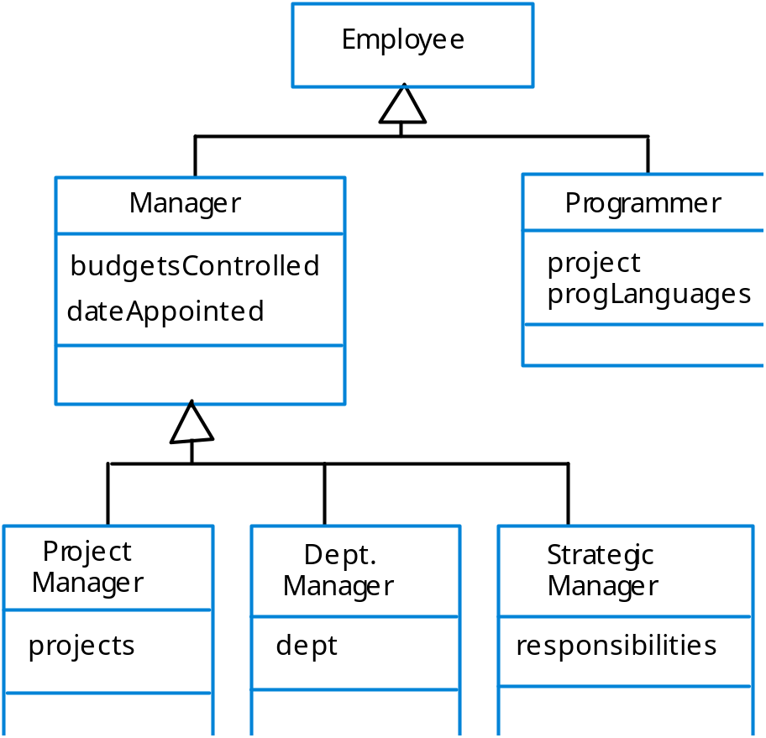
A generalisation hierarchy

Slide 70
Generalization
A sub-class inherits from its super-class
  Attributes
  Operations
  Relationships
A sub-class may
  Add attributes and operations
  Add relationships
  Refine (override) inherited operations
UML Class Diagrams

Slide 71
Generalization
Account
One class shares the structure and/or behavior of one or more classes
“Is-a-kind of” relationship
In analysis, use sparingly
Inheritance relationships may be identified – especially in
entity classes.
balance
Superclass (parent)
name
number
Withdraw()
CreateStatement()
Generalization Relationship
In analysis, generalization should be
used to model shared behavioral
semantics only (that is, generalization
that passes “is a kind of’ test)
The use of generalization makes the
definition of the abstractions easier to
document and understand.
Checking
Savings
Subclasses
Withdraw()
GetInterest()
Withdraw()
When generalization is found,
create a common super-class
that contains common attributes
associations, aggregations, and
operations
Notes:
OOADv4.2 Instructor Notes
Module 7 - Use-Case Analysis
Generalization used in analysis should be so obvious from the abstraction definitions, that it “hits you in the head with a 2-by-4”.

Slide 72
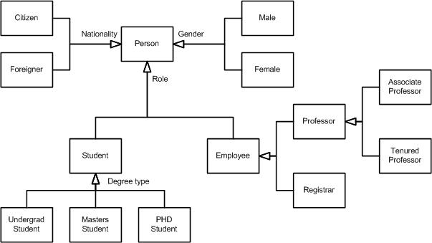
Example

Slide 73
Realization
A realization relationship indicates that one class implements a behavior specified by another class (an interface or protocol).
An interface can be realized by many classes.
A class may realize many interfaces.
LinkedList
<<interface>>
List
LinkedList
List
UML Class Diagrams

Slide 74
Describe Event Dependencies between Analysis Classes
A subscribe-association between two objects indicates that the subscribing object will be informed when a particular event has occurred in the subscribed object.

Slide 75
Constraint Rules and Notes
Constraints and notes annotate among other things associations, attributes, operations and classes.
Constraints are semantic restrictions noted as Boolean expressions.
  UML offers many pre-defined constraints.
Customer
id: long { value > 0 }
1
*
Order
may be canceled
{ total < $50 }
Constraint
Note
UML Class Diagrams

Slide 76
Summary of Analysis Classes: View of Participating Classes (VOPC)
For each use-case realization there is one or more class diagrams depicting its participating classes, along with their relationships.
Such class diagrams have been called “View of Participating Classes” diagrams (VOPC, for short) – next overhead…

Slide 77
UML class diagrams
What is a UML class diagram?
What are some things that are not represented in a UML class diagram?
  UML class diagram: a picture of the classes in an OO system, their fields and methods, and connections between the classes that interact or inherit from each other
  details of how the classes interact with each other
  algorithmic details; how a particular behavior is implemented

Slide 78
UML class diagrams
A class diagram is a STATIC view of system.
A class diagram describes the types of objects in the system and the various kinds of static relationships that exist among them.
  A graphical representation of a static view on declarative static elements.
UML Class Diagrams

Slide 79
Classes are Blueprints
A class defines the general nature of a collection of objects of the same type.
The process creating an object from a class is called instantiation.
Every object is an instance of a particular class.
There can be many instances of objects from the same class possible with different values for data.
A class structure implements encapsulation as well as access control: private, public, protected.
B. Ramamurthy

Slide 80
Example: Summary: Analysis Classes - VOPC
The diagram here shows the classes participating in the Register for Courses use case
The part-time student and full-time student classes have been omitted for brevity (they
both inherit from Student. Class relationships will be discussed later.
Student
Register for Courses
Course Catalog System
Use-Case Model
Design Model (classes only listed – no relationships shown here…)
<<boundary>>
RegisterForCoursesForm
<<control>>
RegistrationController
<<boundary>>
CourseCatalogSystem
<<entity>>
Student
<<entity>>
Schedule
<<entity>>
CourseOffering
Notes:
OOADv4.2 Instructor Notes
Module 7 - Use-Case Analysis
Note: This slide is a summary of all of the other example slides for this step.
The Part-Time Student and Full-Time Student classes have been omitted from the diagram for clarity.

Slide 81
Essential Elements of a UML Class Diagram
Class
Attributes
Operations
Relationships
  Associations
  Generalization
  Dependency
  Realization
Constraint Rules and Notes
UML Class Diagrams

Slide 82
Example
Brain
Person
Money
Class
Student
takes

Slide 83
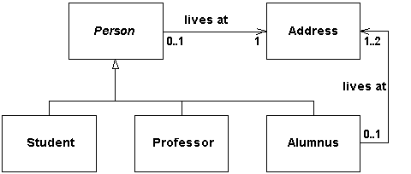
Example

Slide 84
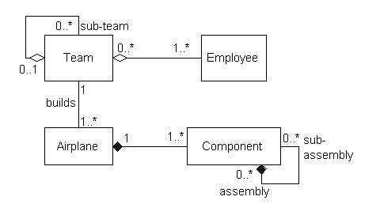
Example

Slide 85
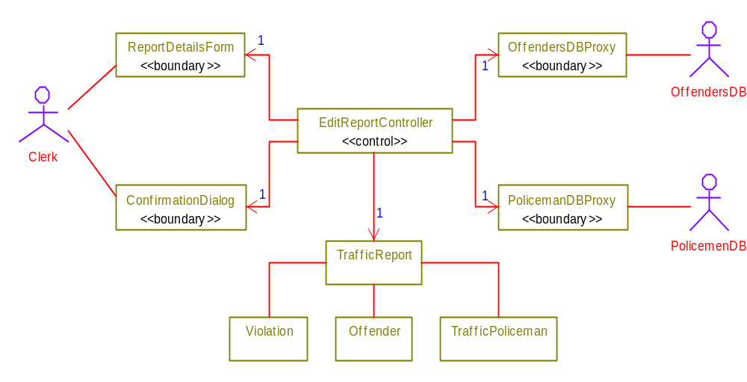
TVRS Example
UML Class Diagrams

Slide 86
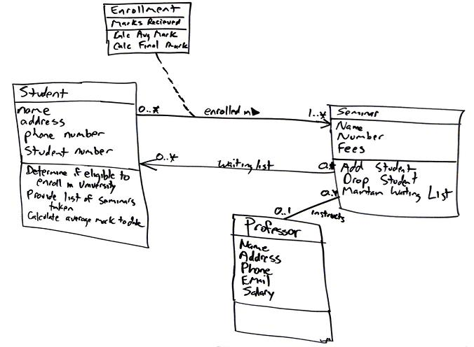

Slide 87
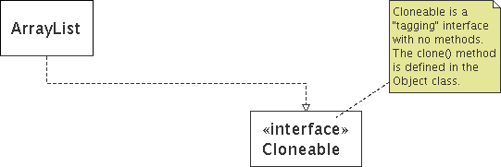
Comments
represented as a folded note, attached to the appropriate class/method/etc by a dashed line

Slide 88
UML Packages
A package is a general purpose grouping mechanism.
  Can be used to group any UML element (e.g. use case, actors, classes, components and other packages.
Commonly used for specifying the logical distribution of classes.
A package does not necessarily translate into a physical sub-system.
Name
UML Class Diagrams

